Slide 1
Taxi Cancellations
Dhakshin Subbaiah and Will Schneider

Slide 2
The problem
Taxi Cancellations
Impacts
Objective
Service Reliability
Operational Efficiency
Customer Satisfaction
Financial Losses
Resource Allocation
Strategic Planning
Using an multitude of model types, to effectively predict cancellations to optimize service and reduce operational losses.

Slide 3

ChatGPT Prompt:
“That’s in the right direction, but show even more revenue lost and the taxi driver is losing his mind.”

Slide 4

“Awesome! But can you make the taxi driver losing even more revenue and he is aggressively freaking out, to the point where he may or may not be a danger to those around him? Can you also make the image more wide angle?”

Slide 5
Data Overview
Dimensions: 10,000 records and 23 attributes (14 used in the model)
Key Attributes:
Geographic Coordinates: ‘from_lat’, ‘from_long’ (pickup locations), ‘to_lat’, ‘to_long’ (drop-off locations)
Trip Characteristics: ‘travel_type_id’, ‘vehicle_model_id’, and ‘trip_length’
Booking Details: ‘from_date’, ‘to_date’, ‘online_booking’, and ‘mobile_site_booking’.
Cancellation Indicator: ‘Car_Cancellation’ (binary outcome variable)
Data Types
Numeric / Integer
Categorical (Factors): varying degrees of levels
Character: Days of the week variables (text)
Temporal: Dates (range of data: 1/1/2013 - 12/15/2013)

Slide 6
Data Pre-Processing
Missing values were replaced with 0s
Not ideal, could use imputation
Changed some of the numerical variables to factors
Certain predictors were still treated as numeric despite it being categorical
Converted date to two variables, time and day of the week
Calculated trip length using the gps data

Slide 7
Analytical Tools & Methods
KNN
Rationale: Effective in scenarios where the decision boundary is irregular.
Decision Tree / Random Forest
Rationale: Capture non-linear relationships without variable transformation. Robust and simple interpretation.
Logistic Regression
Rationale: Insights into influence of various features on the probability of cancellations. Easy interpretability of model coefficients.
Ensemble
Rationale: leverage the strengths and mitigate the weaknesses of individual models.

Slide 8
Textbook Models
Model | Accuracy | AUC | Specifi. FN Rate | Sensitiv. TP Rate
KNN | 0.9252 | 0.6044 | 0.6689% | 99.94%
XGBoost | 0.9202 | 0.7901 | 10.70% | 98.59%
Random Forest | 0.9252 | 0.6664 | 0.00% | 100%
Logistic Reg. | 0.137 | 0.5755 | 80.00% | 25.51%
Ensemble | 0.9292 | 0.8862 | 1.049% | 100.00%
Performance

Slide 9
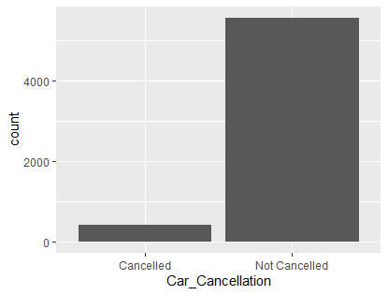
Issues
The training data set is unbalanced leading to poor model performance
Most variables are factors but are used as numeric predictors
Most models predict that all rides are not cancelled

Slide 10
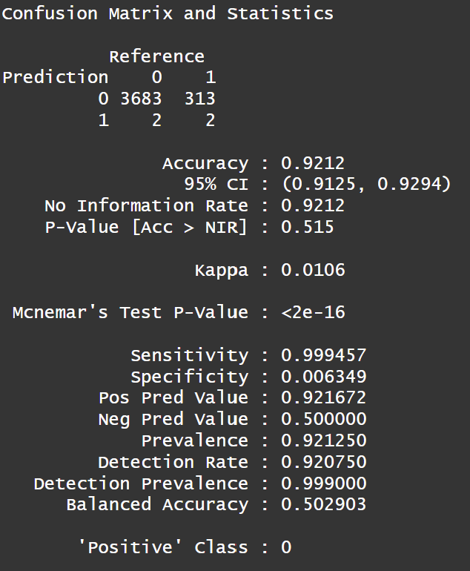
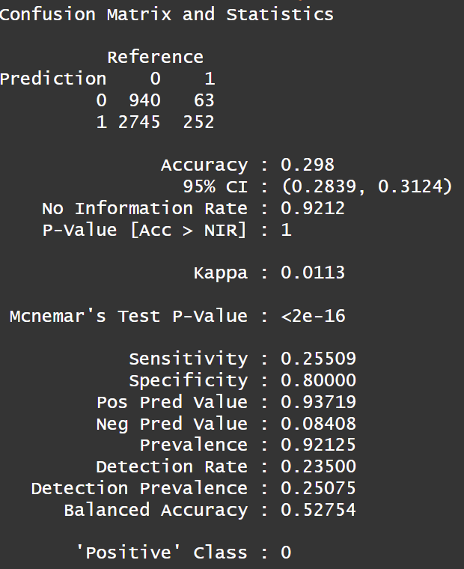
Issues

Slide 11
Impact of False Positives and Negatives
False Positives (Type I Error): Predicting a cancellation that does not actually happen can cause taxis to be prematurely redirected or kept idle, waiting for other booking requests. This not only wastes resources but also leads to missed opportunities for genuine bookings.
False Negatives (Type II Error): Not predicting a cancellation that does happen means a customer gets left stranded and could potentially miss whatever appointment they might have.

Slide 12
Improved Model Performances
SMOTE (Synthetic Minority Over-sampling Technique) - Data Balance
KNN
Model Tuning: (1) Custom scoring function focusing on specificity. (2) SMOTE sampling
Random Forest
Applied higher weights to cancellation instances. No SMOTE
AdaBoost
SMOTE marginally affected overall performance, improved TNR (cancels.) performance by 250%
Logistic Regression
Data balancing reduced TNR but overall predicted more correct classes
Penalized Regression did not increase performance
Ensemble
Has the highest overall AUC and second highest TNR. Robust predictions.

Slide 13
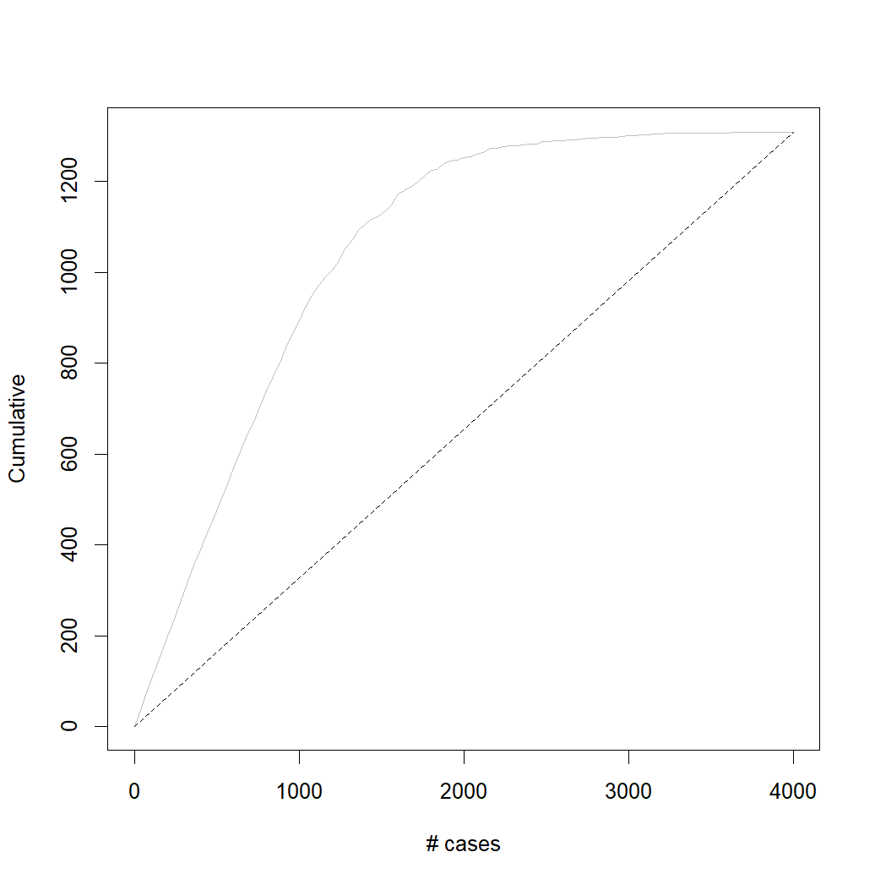
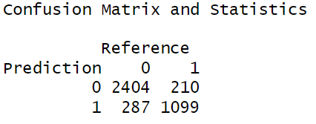
Evaluation Metrics
Specificity: proportion of actual negatives correctly identified. Impact: False Alarm reduction, Better Cancellation detection
AUC: class discrimination. Impact: better overall model performance & threshold independent
Accuracy: overall correctness. Impact: general correctness of the model

Slide 14
Why High Specificity?
Sensitivity (True Positive Rate):
Minimizes false negatives to ensure that non-cancellations are rarely misclassified.
Specificity (True Negative Rate):
Prioritized in the model to reduce false positives, ensuring all potential cancellations are considered
Cost of Low Specificity: underutilized taxis, increased operational costs, and customer dissatisfaction, ultimately harming revenue and brand trust.
Strategic Importance (High Specificity): enhances operational efficiency and customer satisfaction by ensuring resources are optimally allocated and service disruptions minimized.

Slide 15
Improved Models
Model | Accuracy | AUC | Specifi. FN Rate | Sensitiv. TP Rate
KNN | 0.8178 | 0.5720 | 27.42% | 86.16%
XGBoost | 0.9142 | 0.7828 | 17.39% | 97.41%
Random Forest | 0.6798 | 0.7361 | 67.56% | 68.01%
Logistic Regress. | 0.7442 | 0.7302 | 40.47% | 77.17%
Ensemble | 0.8758 | 0.9417 | 83.96% | 89.33%
Performance

Slide 16
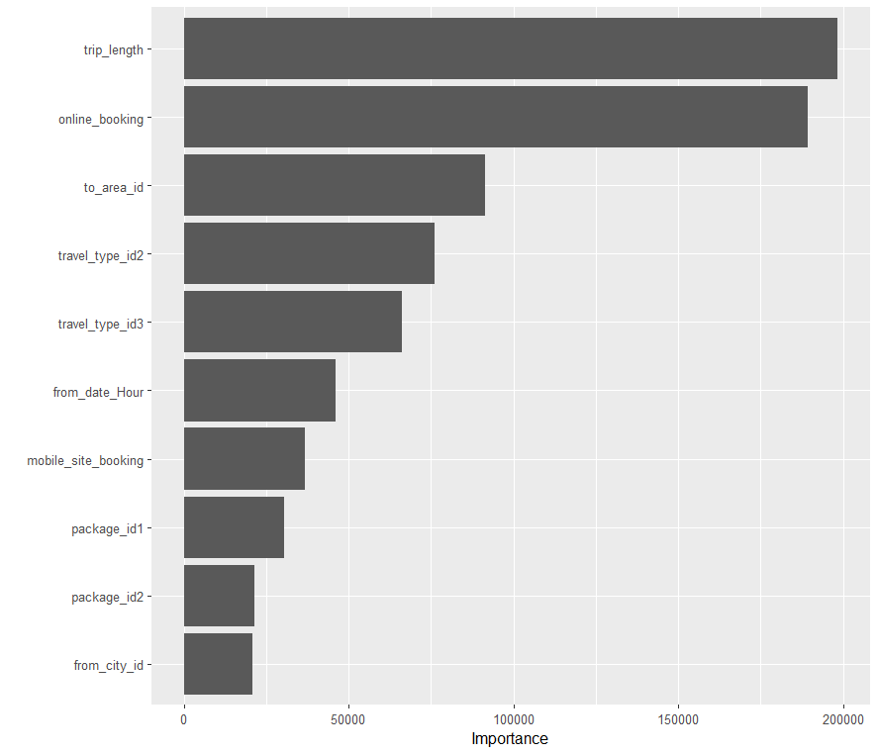
Variable Importance : Random Forest
Longer trips may be associated with higher cancellation rates due to factors such as changes in customer plans or unexpected delays
Online Bookings = Commitment, resulting in fewer cancellations compared to those who book through other means.
Certain areas have higher cancellation rates due to factors such as traffic congestion, accessibility, or specific events

Slide 17
Potential Solutions
Order the potential drivers based on the likelihood they cancel for their scheduled call
For ties give priority to drivers who cancel less often
With this potential solution we can deal with cancellations by going to the second best option
What can YourCabs.com do with a successful model

Slide 18
Conclusion
The out of the box models provided by the textbook were poor
Class Imbalance
Most variables were treated as numerical
Data Preprocessing and exploratory data analysis were crucial to model improvement
Indicated that we needed to deal with the class imbalance
Interesting and applicable use case of ensemble method
Data Imbalance still challenging to unseen data.

